Slide 1
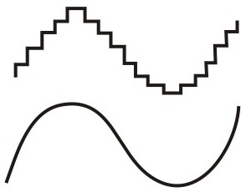
DAC in STM32F4
device that has the opposite function to that of an analogue to digital converter
It converts digital binary values to analogue voltage outputs.
The DAC block has several uses including audio generation, waveform generation, etc.

Slide 2
Main features:
STM32F4xxxx microcontrollers integrate DAC with different configurations and features:
• 2 DAC output channels
• Noise waveform generation
• Triangular waveform generation
• DMA under run flag
• Dedicated analog clock

Slide 3
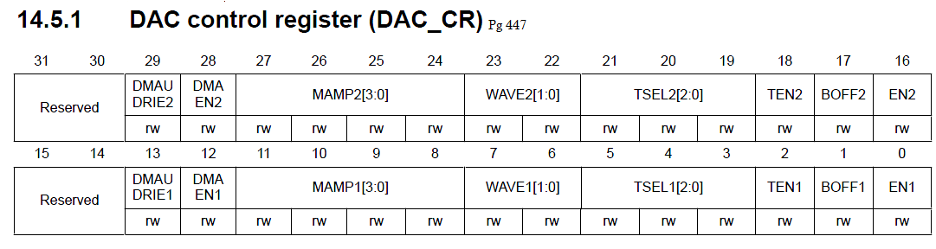
DAC channel enable
ENx: DAC channelx enable
0: DAC channelx disabled
1: DAC channelx enabled
The DAC channel is then enabled after a startup time tWAKEUP.

Slide 4
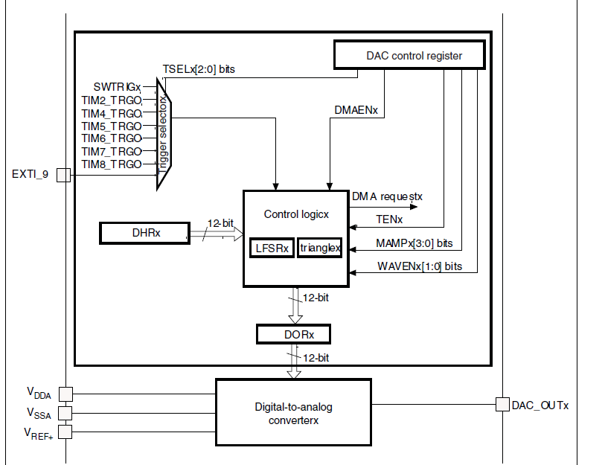
DAC conversion
DAC_DORx cannot be written directly
Data in DAC_DHRx → DAC_DORx when triggered
1
2
3

Slide 5
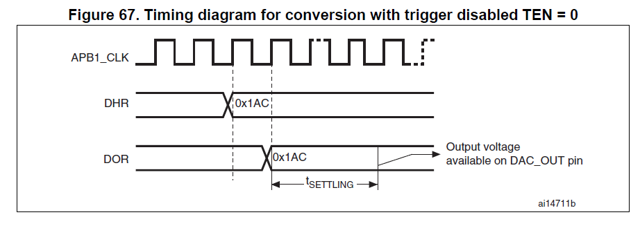
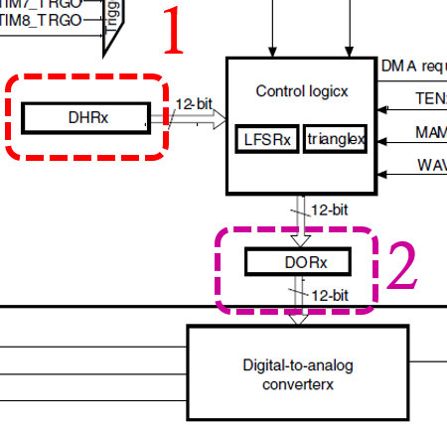
DAC conversion
Without hardware trigger
after one APB1 clock cycle,
if no hardware trigger (TENx bit in DAC_CR register is reset) or software trigger is selected
If the software trigger is selected, the conversion starts once the SWTRIG bit is set.

Slide 6
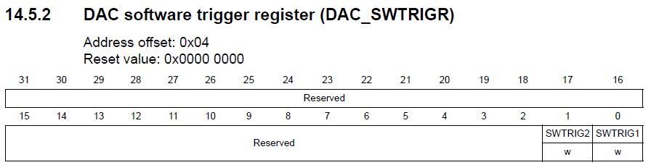
DAC conversion
Technical details
SWTRIGx: DAC channelx software trigger
This bit is set and cleared by software to enable/disable the software trigger.
0: Software trigger disabled
1: Software trigger enabled
Note: This bit is cleared by hardware (one APB1 clock cycle later) once
- If the software trigger is selected, the conversion starts once the SWTRIG bit is set.
SWTRIG is reset by hardware once the DAC_DORx register has been loaded with the
DAC_DHRx register contents.

Slide 7
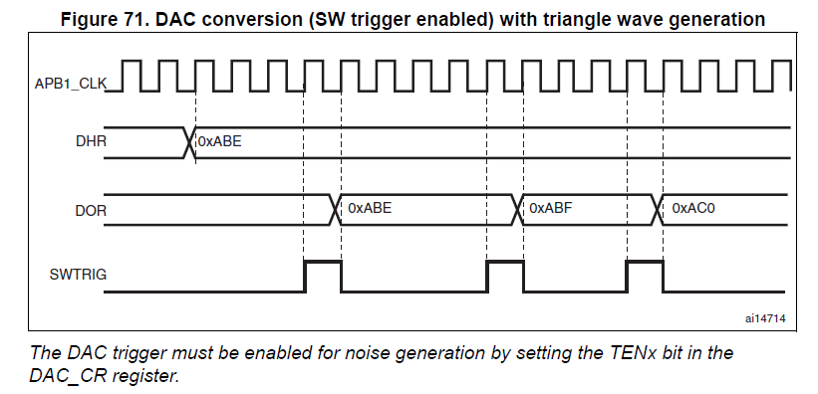
DAC conversion
With hardware trigger
a hardware trigger is selected (TENx bit in DAC_CR register is set)
the transfer is performed three APB1 clock cycles later when a trigger occurs

Slide 8
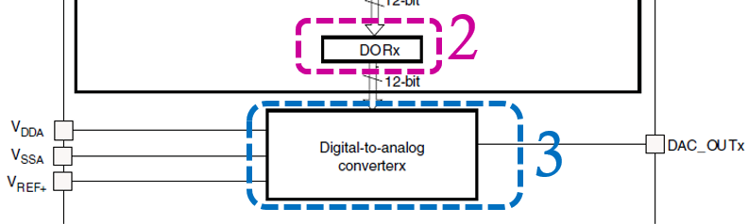
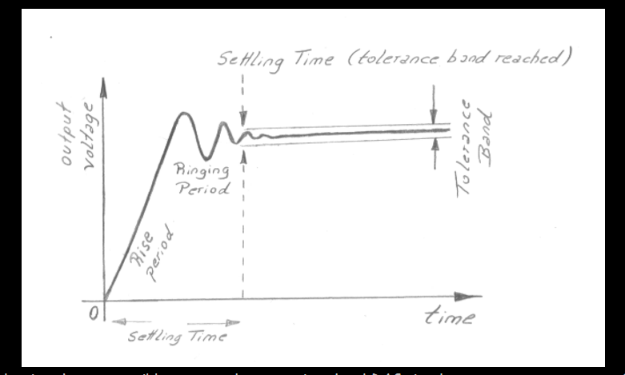
DAC conversion
When DAC_DORx is loaded with the DAC_DHRx contents
the analog output voltage becomes available after a time tSETTLING that depends on the power supply voltage and the analog output load.
time tSETTLING
For a DAC, settling time is the interval between a command to update (change) its output value and the instant it reaches its final value, within a specified percentage.
Settling time is affected by the slew rate of an output amplifier and by the amount of amplifier ringing and signal overshoot
The built-in DACs of the STM32F4 have a settling time of 3µs(https://thegloriousfiveyearplan.wordpress.com/2015/10/19/stm32f4-dac-multiplexing-with-sample-and-hold/)

Slide 9
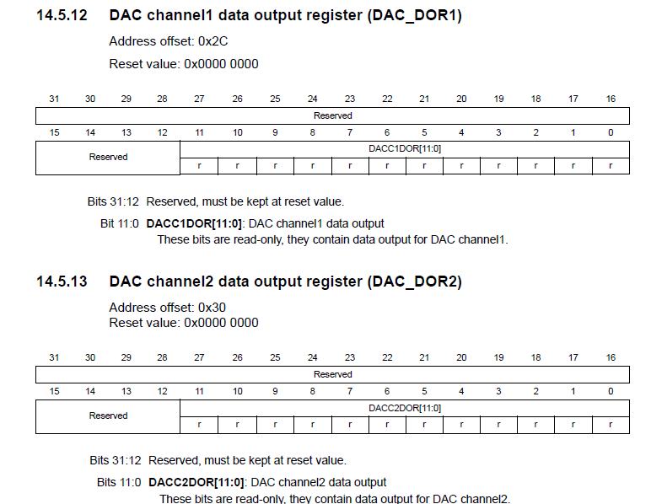
DAC conversion
Technical details
Pg 454

Slide 10
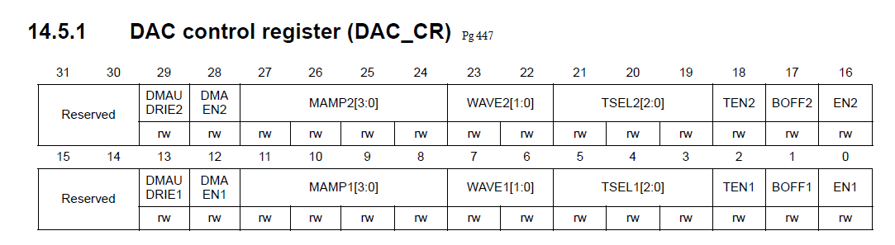
DAC trigger Enable
Technical details
TENx: DAC channelx trigger enable
0: DAC channel2xtrigger disabled and data written into the DAC_DHRx register are transferred one APB1 clock cycle later to the DAC_DOR2 register
1: DAC channel2 trigger enabled and data from the DAC_DHRx register are transferred three APB1 clock cycles later to the DAC_DOR2 register
Note: When software trigger is selected, the transfer from the DAC_DHRx register to the
DAC_DOR2 register takes only one APB1 clock cycle.

Slide 11
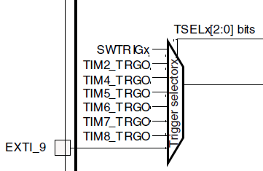
Technical details
DAC trigger selection
TSELx[2:0]: DAC channelx trigger selection
These bits select the external event used to trigger DAC channelx
000: Timer 6 TRGO event
001: Timer 8 TRGO event
010: Timer 7 TRGO event
011: Timer 5 TRGO event
100: Timer 2 TRGO event
101: Timer 4 TRGO event
110: External line9
111: Software trigger
Note: Only used if bit TEN2 = 1 (DAC channel2 trigger enabled).

Slide 12
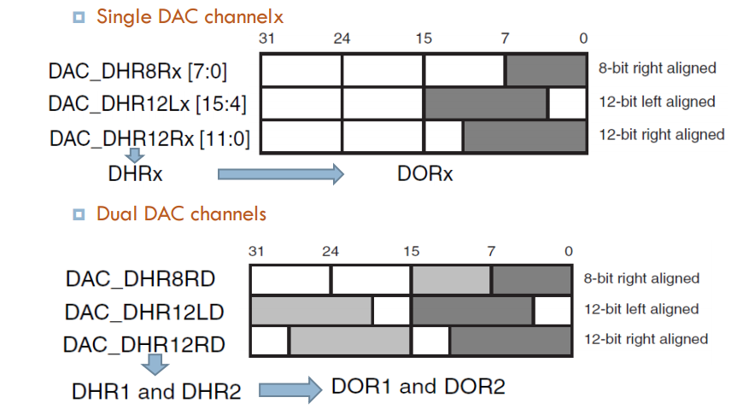
3 integer formats:
8-bit, 12-bit right aligned and 12-bit left aligned.
A 12-bit value can range from 0x000 to 0xFFF
Data format

Slide 13
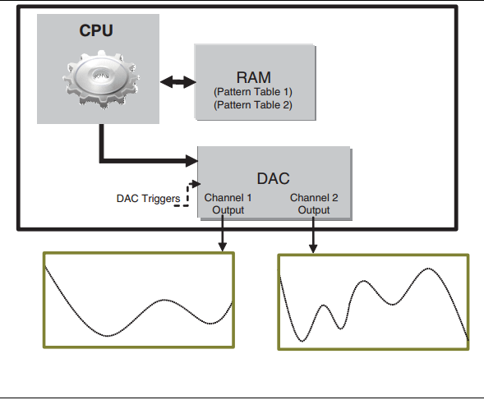
Why DAC need to interact with DMA?
DAC interaction without DMA
CPU provide the pattern waveform to DAC
the waveform is saved in a memory (RAM)
the CPU is in charge of transferring the data from RAM to the DAC.

Slide 14
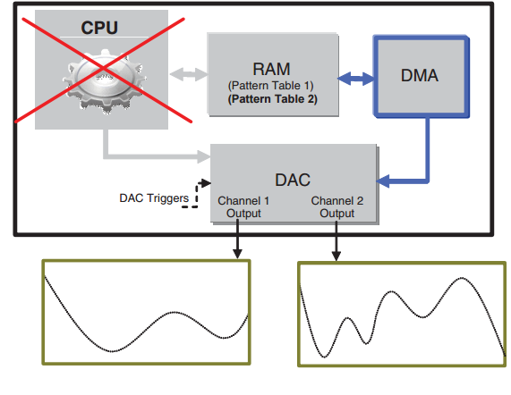
DAC interaction with DMA
freeing up the core
the overall performance of the system is increased
data is moved from memory to DAC by DMA
this keeps CPU resources free for other operations.
The STM32 microcontrollers have a DMA module with multiple channels.
Each DAC channel is connected to an independent DMA channel.

Slide 15
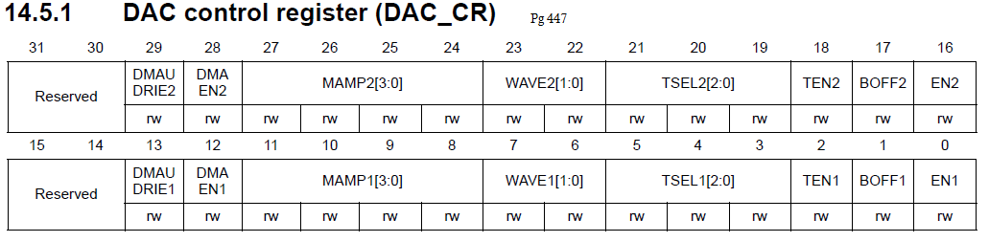
DAC interaction with DMA
Technical details
DMAENx: DAC channelx DMA enable
This bit is set and cleared by software.
0: DAC channelx DMA mode disabled
1: DAC channelx DMA mode enabled

Slide 16
DAC interaction with DMA
DMA request is generated when an external trigger (but not a software trigger)
occurs while the DMAENx bit is set.
The value of the DAC_DHRx register is then transferred into the DAC_DORx register.

Slide 17
DMA underrun error
DMA transfer is slower than the DAC conversion
In this case, DAC detects that a part of the pattern waveform has been ignored and was not converted.
It then sets the "DMA underrun Error" flag
Why DMA underrun happened?
How to solve
Asynchronous trigger
using a shared IRQ channel with the triggering Timer
or by a dedicated interrupt when DAC is not triggered by TIM6.

Slide 18
DMA underrun error
Technical details
DMAUDRIEx: DAC channelx DMA underrun interrupt enable
This bit is set and cleared by software.
0: DAC channelx DMA underrun interrupt disabled
1: DAC channelx DMA underrun interrupt enabled
interrupt is also generated if its corresponding DMAUDRIEx bit in the DAC_CR register is enabled.

Slide 19
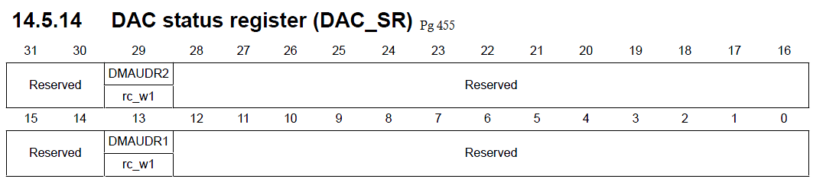
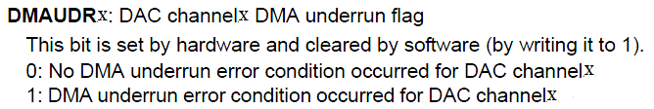
DMA underrun error

Slide 20
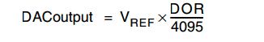
DAC output voltage
The analog output voltages on each DAC channel pin are determined by the following equation:

Slide 21
Output buffers
To drive external loads
without using an external operational amplifier
DAC channels have embedded output buffers
can be enabled and disabled depending on the user application.
used to reduce the output impedance
DAC may require output buffering to achieve optimum performance.

Slide 22
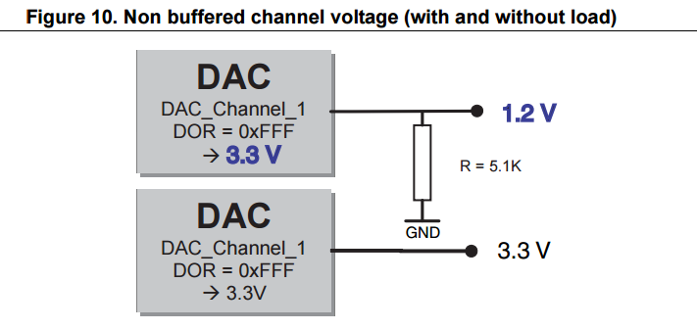
Output buffers
Non buffered output
there is a load in the user application circuit
the voltage output will be lower than the desired voltage

Slide 23
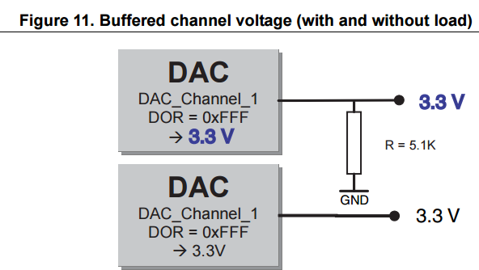
Output buffers
Buffered output
the voltage output and the voltage desired are similar

Slide 24
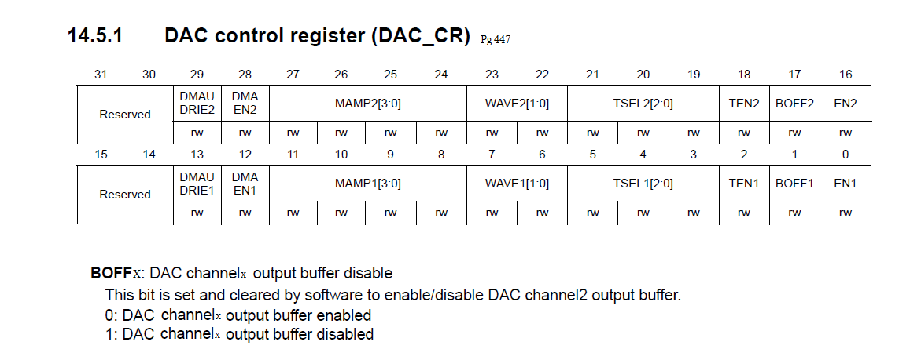
Output buffers
Technical details

Slide 25
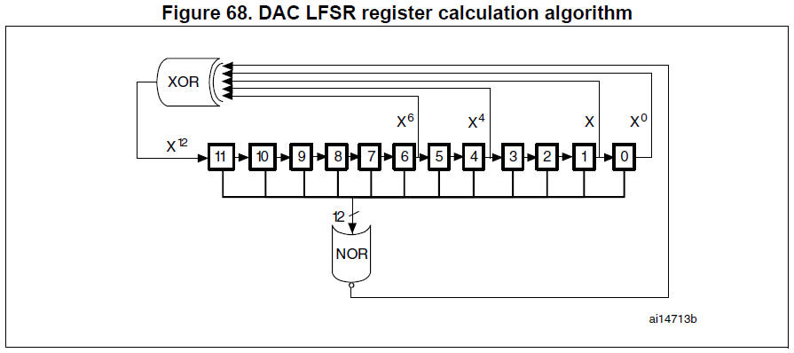
White noise generator
pseudo random code generator, sketched in figure below.
Depending on what taps are used on the shift register, a sequence of up to 2n-1 numbers can be generated before the sequence repeats.

Slide 26
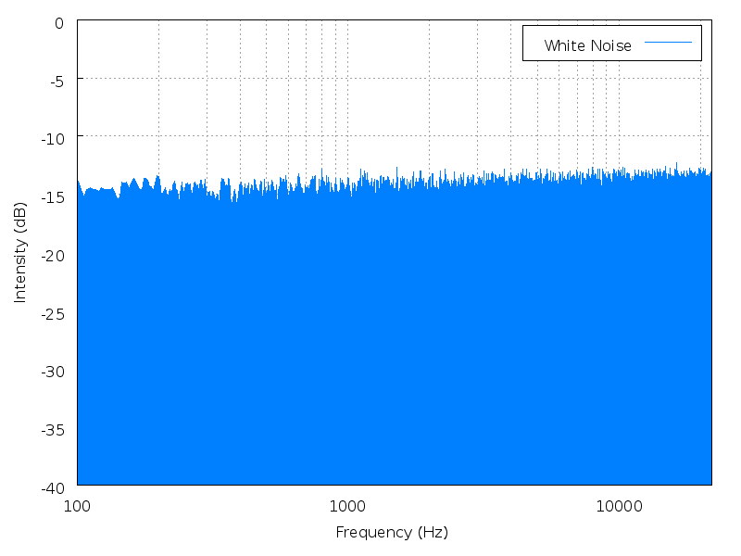
FYI
White noise
signal with a flat frequency spectrum when plotted as a linear function of frequency
In other words, the signal has equal power in any band of a given bandwidth (power spectral density)
Tinnitus maskers
is one of the only solutions available for tinnitus relief.
- Tinnitus is a condition in which an individual hears a roaring or ringing of the ears.( 耳鸣)

Slide 27
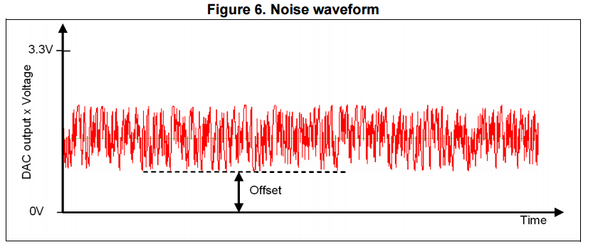
White noise generator
noise produced has a flat spectral distribution
can be considered white noise.
The offset of the noise waveform is programmable.
By varying this offset using a preconfigured table of offsets (signal pattern), user can obtain a waveform which correspond to the sum of the signal pattern and the noise waveform.

Slide 28
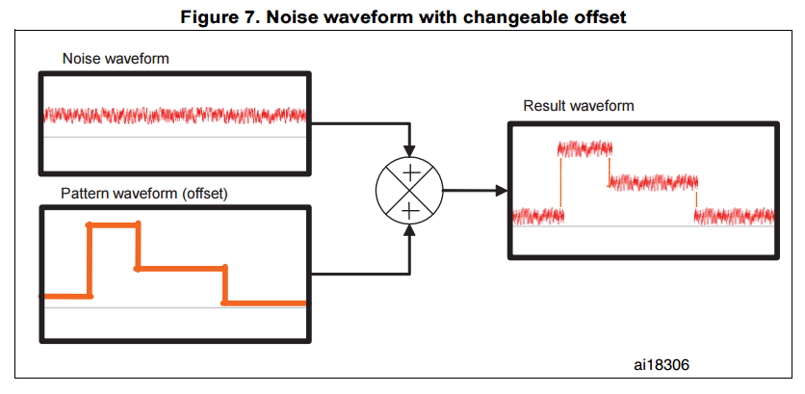
White noise generator
In audio systems , white noise is LP filtered with 3dB/ octave to make pink noise used to equalize a room from dominant resonances with suitable mics.

Slide 29
White noise generator
Typical applications
an input for a filter to create other types of noise signal. It is used extensively in audio synthesis,
typically to recreate percussive instruments such as cymbals which have high noise content in their frequency domain.
White noise generator can be used for control engineering purposes, it can be used for frequency response testing of amplifiers and electronic filters.
White noise is a common synthetic noise source used for sound masking by a Tinnitus masker.

Slide 30
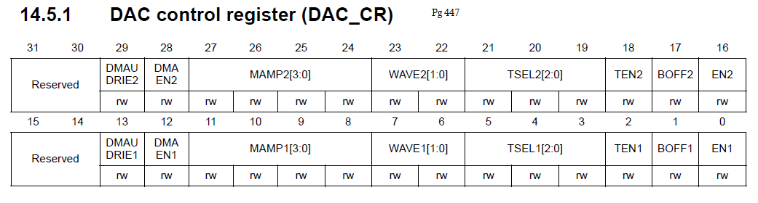
White noise generator
Technical details
WAVEx[1:0]: DAC channelx noise/triangle wave generation enable
These bits are set/reset by software.
00: wave generation disabled
01: Noise wave generation enabled
1x: Triangle wave generation enabled
Note: Only used if bit TEN2 = 1 (DAC channel2 trigger enabled)

Slide 31
White noise generator
Technical details
The preloaded value in LFSR is 0xAAA.
This register is updated three APB1 clock cycles after each trigger event, following a specific calculation algorithm.

Slide 32
White noise generator
Technical details
The LFSR value, that may be masked partially or totally by means of the MAMPx[3:0] bits in the DAC_CR register,
is added up to the DAC_DHRx contents without overflow and this value is then stored into the DAC_DORx register.
If LFSR is 0x0000, a ‘1 is injected into it (antilock-up mechanism).
It is possible to reset LFSR wave generation by resetting the WAVEx[1:0] bits.

Slide 33
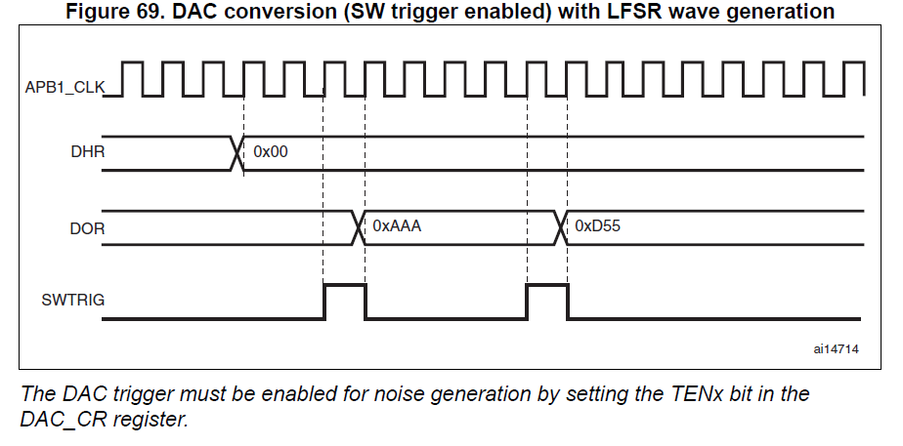
White noise generator

Slide 34
Triangular wave generator
are often used in sound synthesis as its timbre is less harsh than the square wave because the amplitude of its upper harmonics falls off more rapidly.
with a flexible offset, amplitude and frequency.
The amplitude of the triangular waveform can be fixed using the MAMPx bits in the DAC_CR register

Slide 35
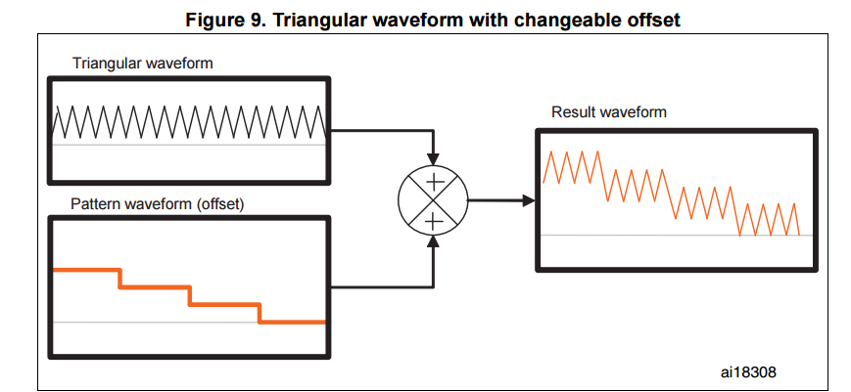
Triangular wave generator
An internal triangle counter
is incremented three APB1 clock cycles after each trigger event
stored into the
DAC_DORx register
DAC_DHRx register

Slide 36
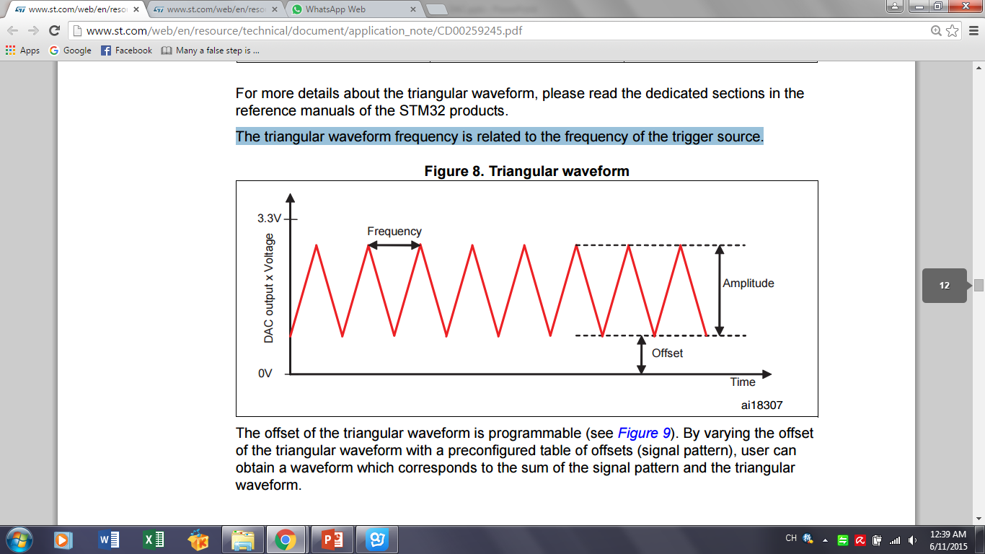
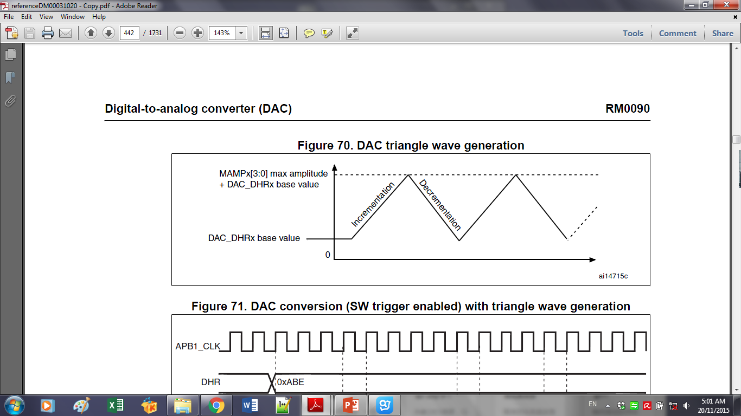
Triangular wave generator

Slide 37
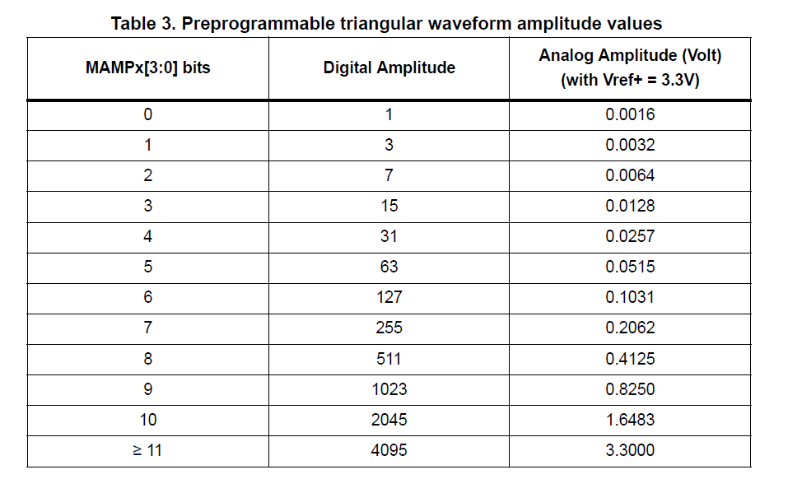

Slide 38
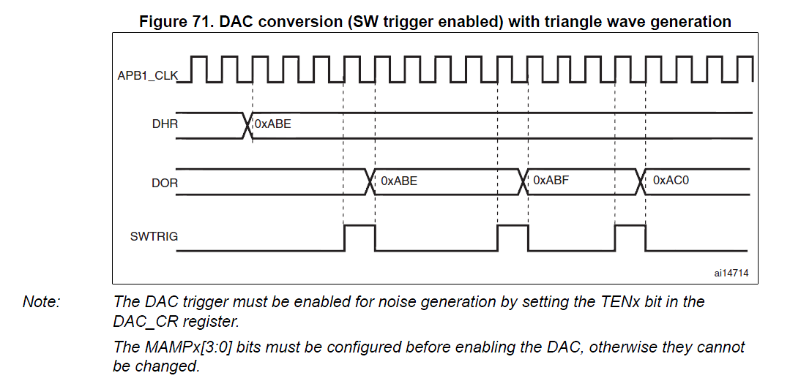

Slide 39
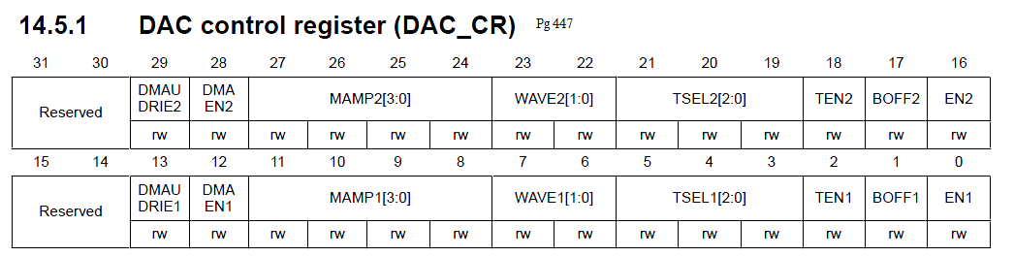
Triangular wave generator
Technical details

Slide 40
MAMPx[3:0]: DAC channelx mask/amplitude selector
These bits are written by software to select mask in wave generation mode or amplitude in
triangle generation mode.
0000: Unmask bit0 of LFSR/ triangle amplitude equal to 1
0001: Unmask bits[1:0] of LFSR/ triangle amplitude equal to 3
0010: Unmask bits[2:0] of LFSR/ triangle amplitude equal to 7
0011: Unmask bits[3:0] of LFSR/ triangle amplitude equal to 15
0100: Unmask bits[4:0] of LFSR/ triangle amplitude equal to 31
0101: Unmask bits[5:0] of LFSR/ triangle amplitude equal to 63
0110: Unmask bits[6:0] of LFSR/ triangle amplitude equal to 127
0111: Unmask bits[7:0] of LFSR/ triangle amplitude equal to 255
1000: Unmask bits[8:0] of LFSR/ triangle amplitude equal to 511
1001: Unmask bits[9:0] of LFSR/ triangle amplitude equal to 1023
1010: Unmask bits[10:0] of LFSR/ triangle amplitude equal to 2047
≥ 1011: Unmask bits[11:0] of LFSR/ triangle amplitude equal to 4095
WAVEx[1:0]: DAC channel2 noise/triangle wave generation enable
These bits are set/reset by software.
00: wave generation disabled
01: Noise wave generation enabled
1x: Triangle wave generation enabled
Note: Only used if bit TEN2 = 1 (DAC channel2 trigger enabled)

Slide 41
Dual channel mode
two output channels, each with its own converter
conversions could be done independently or simultaneously
When the channels are triggered by the same source, synchronous update operations and conversions are done simultaneously.

Slide 42
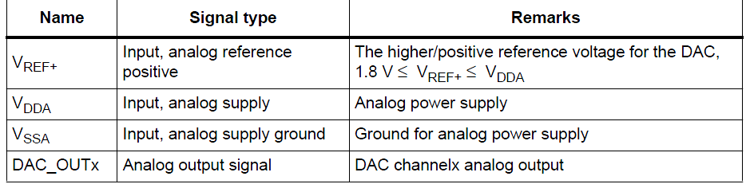

Slide 43
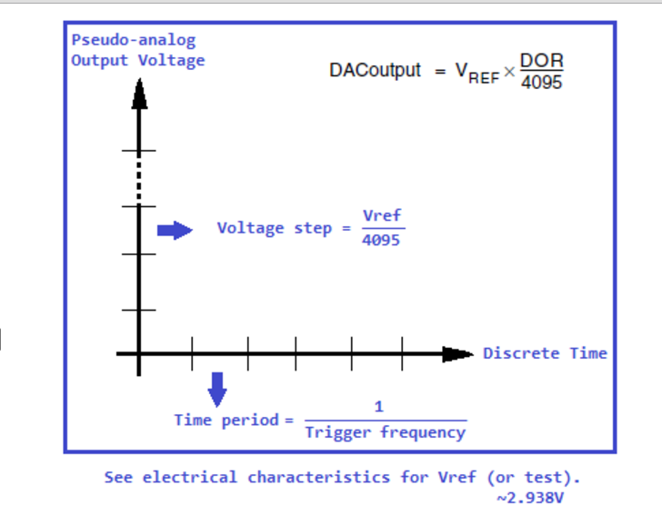
Using the DAC to generate a sine waveform

Slide 44
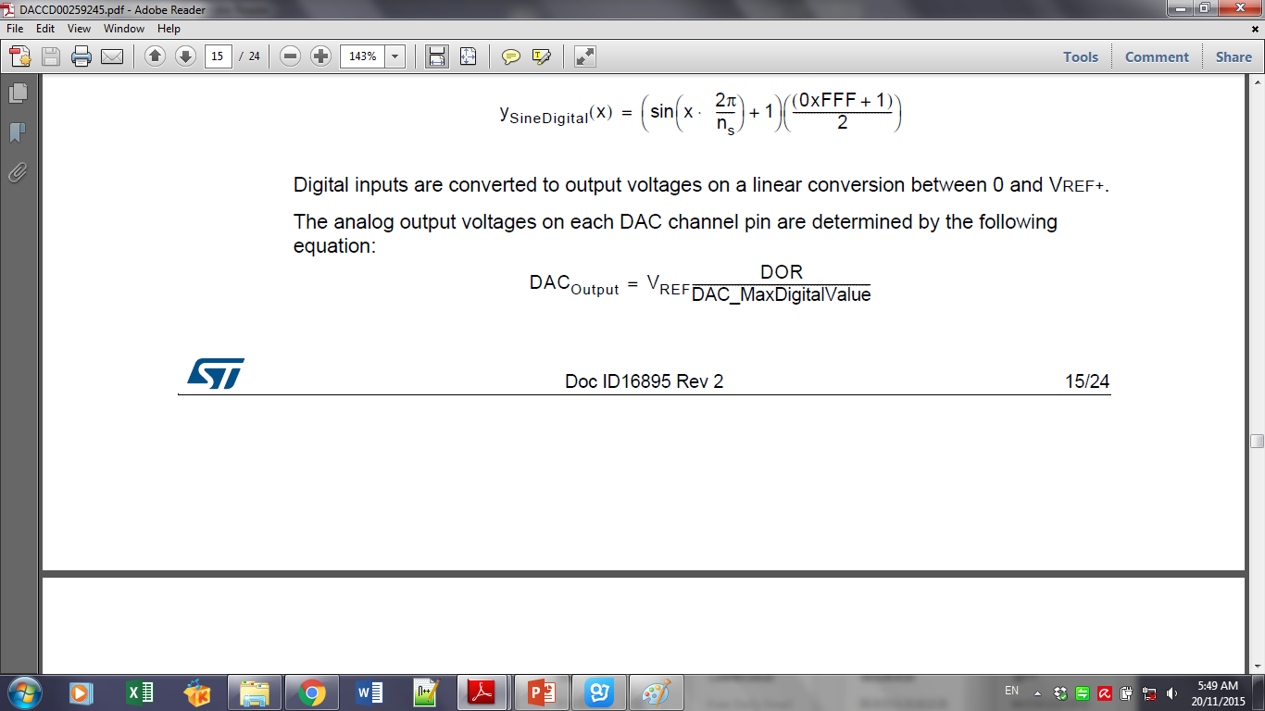
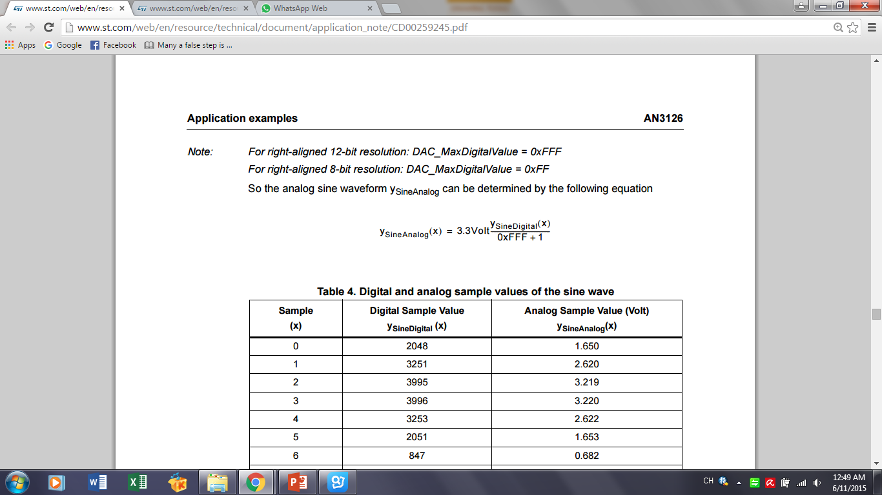
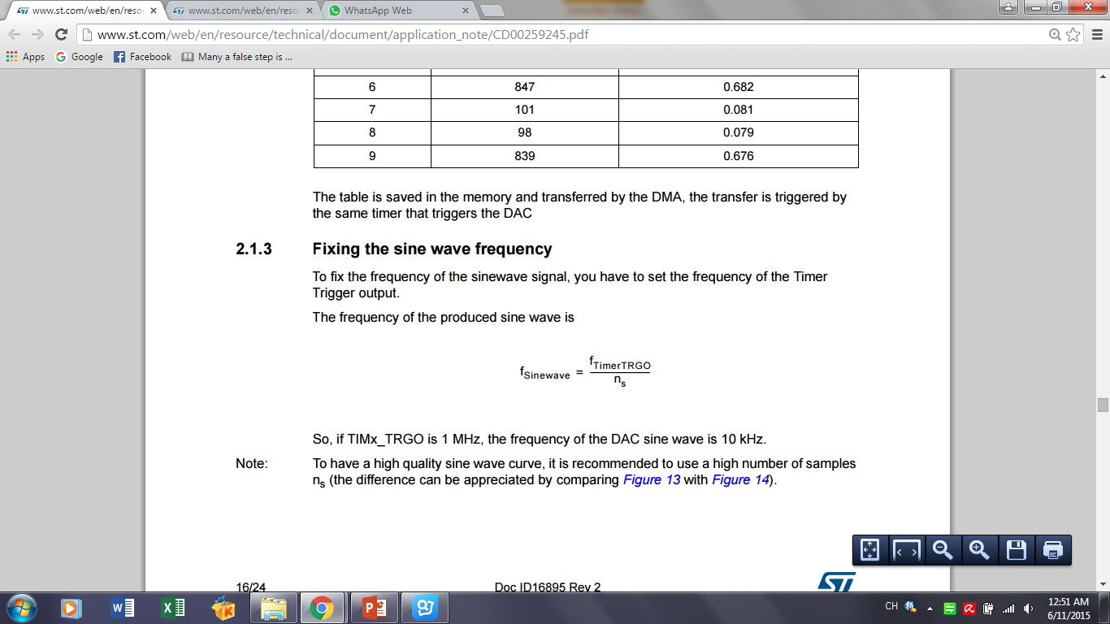
The analog output voltages on each DAC channel pin are determined by the following equation:
analog sine waveform ySineAnalog can be determined by the following equation:
Fixing the sine wave frequency
(number of samples)
To have a high quality sine wave curve, it is recommended to use a high number of samples ns

Slide 45
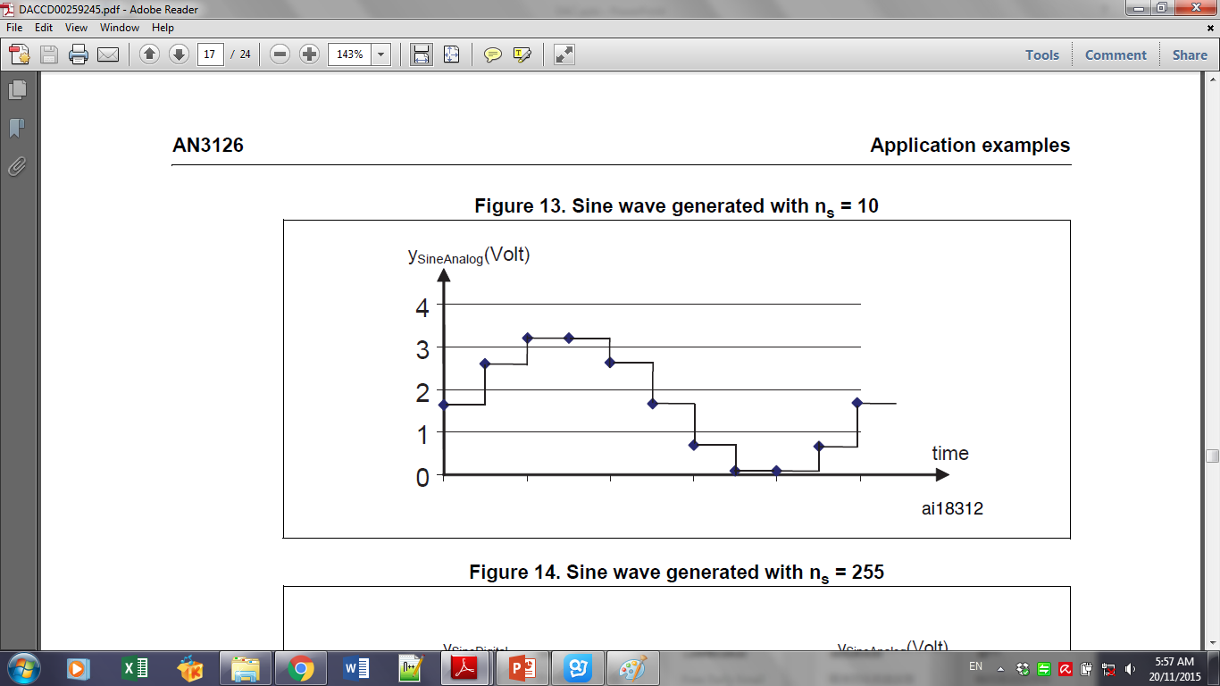
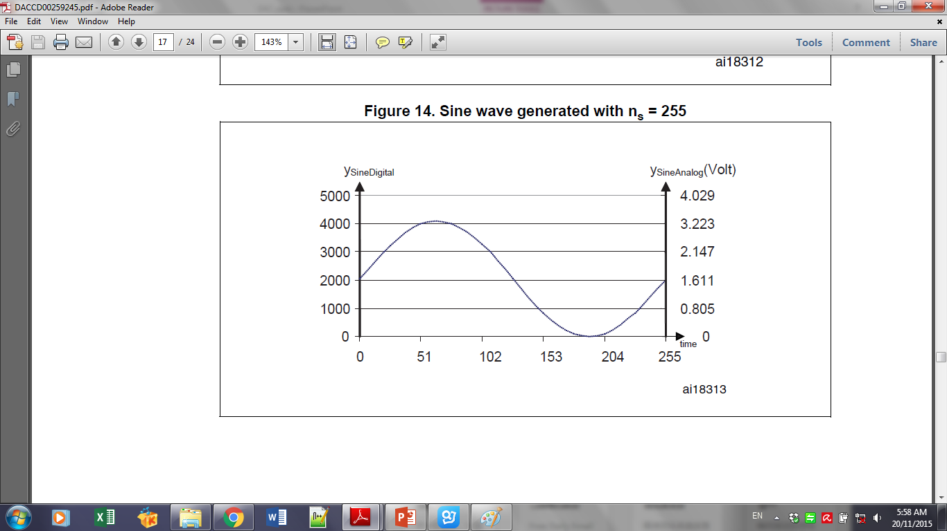
sine waveform with difference ns

Slide 46
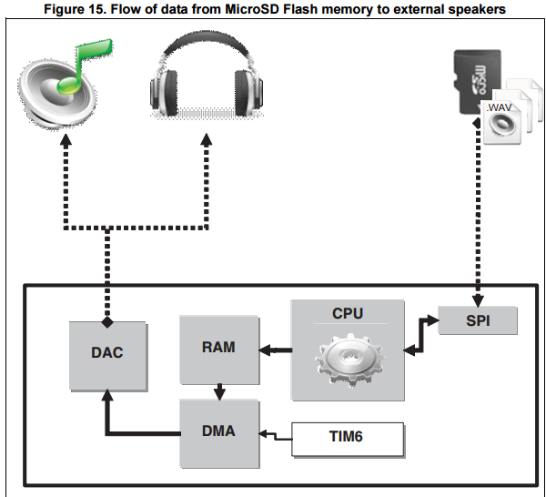
Using the DAC to implement an audio wave player

Slide 47
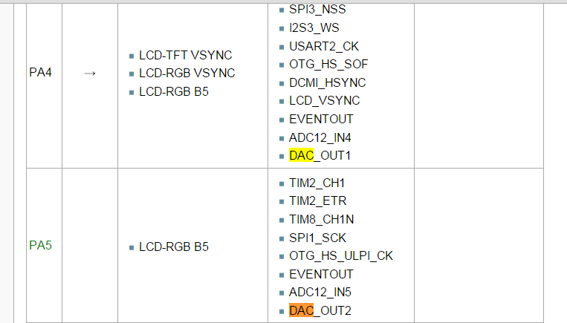

Slide 48

The End

